Slide 1
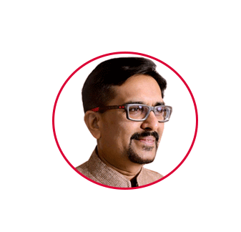

Founder | Instigator
RJ Sir
(Mr. Rajesh Bhavsar)
You
don’t fail,
give up
www.rajeshbhavsar.com | therjsir@gmail.com | +91 77790 10101| +91 90816 28628

Slide 2







PLACEMENT
www.irojgar.com
+91 77790 10101
COACHING
www.racevarsity.com+91 76009 09090
IMMIGRATION
www.goforen.com
+91 76000 14090
CO-WORKING
www.careeriaa.com+91 85111 10221
Since 2006
CAREER OPPORTUNITIES
FOR YOUTH
RJ sir
www.rajeshbhavsar.com | therjsir@gmail.com | +91 77790 10101| +91 90816 28628

Slide 3



Employability Preparedness :
આપણી રોજગાર યોગ્યતા.......
Coaching
Placement
Immigration
Co-Working
JOBS
FOR
JANTA
www.irojgar.com | irojgarmail@gmail.com | +91 77790 10101| +91 90816 28628

Slide 4

SEQUENCE
About RJ sir and creation of iROJGAR
Vision, Mission & Values of iROJGAR
Organizational Tree
Student’s perception of employment
Process flowchart for Job seeker to get a job
Level of jobs and Salary offered
Success stories
Benefits to registered Job seekers
Industries we focus on for job seekers
Services offered by iROJGAR
Our commitment towards job seekers
Contact us
Coaching
Placement
Immigration
Co-Working
JOBS
FOR
JANTA
www.irojgar.com | irojgarmail@gmail.com | +91 77790 10101| +91 90816 28628

Slide 5

ABOUT US
Coaching
Placement
Immigration
Co-Working
Founded by Mr. Rajesh Bhavsar (a technocrat and mentor) in 2015. Currently having a workforce of more than 20 people.
Parent company – RACE - has roots in academics and coaching for the last 18 years.
Headquartered in Surat, South Gujarat. Operating majorly for South Gujarat.
Currently 500+ clientele. Regularly placing more than 50+ candidates in private jobs every months.
JOBS
FOR
JANTA
www.irojgar.com | irojgarmail@gmail.com | +91 77790 10101| +91 90816 28628

Slide 6


DRIVING VISION OF iROJGAR
Coaching
Placement
Immigration
Co-Working
To promote sustainable economic growth by coordinating workforce for proper job placement and thereby enhancing social stability and quality of life of families. It means
JOBS
FOR
JANTA
better work,
better career,
better life.
www.irojgar.com | irojgarmail@gmail.com | +91 77790 10101| +91 90816 28628

Slide 7

MISSION: JOBS FOR JANTA
Inspired by Mission statement of iROJGAR
Right job to each one as well as right employee to each establishment.
Innovative and economical solutions with use of technology to meet job market requirements.
To enhance competitiveness and harmony of job seekers by providing vocational guidance and skill development training.
To partner/collaborate/sign MoU’s with market majors (companies) to ensure large presence for (Indian) job seekers.
To create and maintain the database related to skill requirements of a dynamic Labour market.
Coaching
Placement
Immigration
Co-Working
JOBS
FOR
JANTA
www.irojgar.com | irojgarmail@gmail.com | +91 77790 10101| +91 90816 28628

Slide 8

DIE HARD VALUES OF iROJGAR
Coaching
Placement
Immigration
Co-Working
Empathy
Going the extra mile
Honesty, Integrity and Confidentiality
To remain consistantly consistant
JOBS
FOR
JANTA
www.irojgar.com | irojgarmail@gmail.com | +91 77790 10101| +91 90816 28628

Slide 9



ORGANIZATIONAL CHART
RJ Sir
Coaching
Placement
Immigration
Co-Working
Founder
JOBS
FOR
JANTA
Head of
Department
Web Based Solutions
Advisor on Board
Marketing/Promotion
Front Office
Back Office
MoU’s/Associations
With Other Placement Companies
www.irojgar.com | irojgarmail@gmail.com | +91 77790 10101| +91 90816 28628

Slide 10
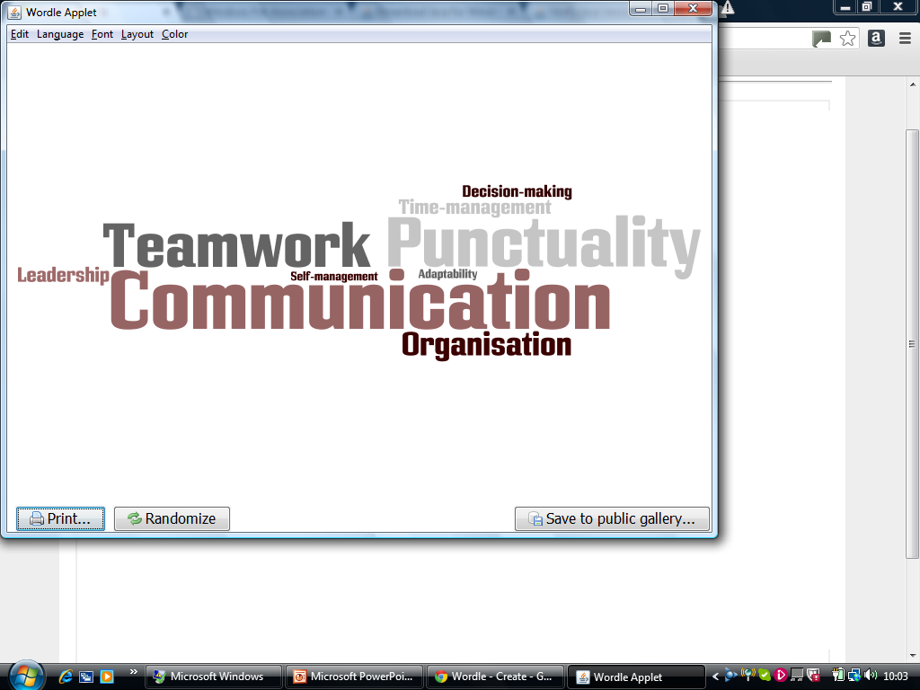
Candidate’s Perceptions for Employability
Coaching
Placement
Immigration
Co-Working
“How likely you are to get a job”.
“The stuff you have to make someone want to give you a job over someone else”.
JOBS
FOR
JANTA
“How well suited you are to a specific job”.
www.irojgar.com | irojgarmail@gmail.com | +91 77790 10101| +91 90816 28628

Slide 11

Process Flow Chart For Getting a job
Coaching
Placement
Immigration
Co-Working
Job Provider
Job Seeker
Directly Connected After Match
JOBS
FOR
JANTA
Register
Post Jobs
Ask for Details on Match
Register
Upload Resume
Apply For Matching Jobs
Get detail after request
Get detail through SMS/ E-mail/ Voice Call
www.irojgar.com | irojgarmail@gmail.com | +91 77790 10101| +91 90816 28628

Slide 12

Process to be followed by Job seeker for getting a JOB-1
Inquiry – Walk in – Registration
Document Preparation/ Verification, Focusing candidate for Presentation in interview
Screening interview at iROJGAR
Resume Forwarded to Job Provider after matching a job
Interview – to be conducted at venue mentioned by Job Provider
Coaching
Placement
Immigration
Co-Working
JOBS
FOR
JANTA
www.irojgar.com | irojgarmail@gmail.com | +91 77790 10101| +91 90816 28628

Slide 13
Process to be followed by Job seeker for getting a JOB-2
6. Outcome of an interview – Not selected/kept on hold/ 2nd round/ Selected
7. After selection candidate decide to join and/or retain job
8. After Joining, JP also decides to retain the candidate.
9. RESPONSIBILITY OF iROJGAR ENDS.
10. Still iROJGAR takes monthly/quarterly/yearly follow up and feedback of both sides to understand the JOB MARKET of SURAT.
Coaching
Placement
Immigration
Co-Working
JOBS
FOR
JANTA
www.irojgar.com | irojgarmail@gmail.com | +91 77790 10101| +91 90816 28628

Slide 14

DOCUMENTS (TO BE KEPT READY) - 1
Coaching
Placement
Immigration
Co-Working
Proof of Birth/Age – School Leaving Certificate, 10th Passing Certificate, Birth date Certificate from Municipal Council, etc.
Qualification – 10th passing, 12th passing, Graduation (all mark sheets), Degree Certificate, Higher Education Certificates, TRANSCRIPT OF SYLLABUS
Skills/ Vocational Development – Typing, Computer Courses, English Proficiency, Any other specific job related skills
Id Proof – Driving Licence, PAN card, Pass port, AADHAR card, Election voter card, Photograph, etc.
JOBS
FOR
JANTA
www.irojgar.com | irojgarmail@gmail.com | +91 77790 10101| +91 90816 28628

Slide 15

DOCUMENTS (TO BE KEPT READY) - 2
Coaching
Placement
Immigration
Co-Working
E. Proof of previous job – Appointment letter, photograph taken on duty, id card of company, etc.
F. Experience Letter – It should thoroughly narrate your duties and responsibilities, designation, signed by authority.
G. Salary – Salary slip, Bank passbook transfer entry, Salary certificate, etc.
JOBS
FOR
JANTA
www.irojgar.com | irojgarmail@gmail.com | +91 77790 10101| +91 90816 28628

Slide 16

Personal presentation of a job seeker - 1
For MEN:
Coaching
Placement
Immigration
Co-Working
Personal grooming-Body cleanliness (Clean shave, properly combed hair, Cut nail, hair on body, tattoo, face grooming, etc.)
Clothes (suitable to job you are applying for, light pastel colour shirt and dark trousers, Best available formal in your wardrobe, pen pocket shall be empty)
Accessories (belt, shoes, ear rings, watch, hand rings, necklace, etc.)
Portfolio (Colour of folder, file of certificates, arrangements, condition of papers in portfolio.)
JOBS
FOR
JANTA
IMPORTANT : YOU MUST SWITCH OFF YOUR MOBILE AND KEEP IT IN BAG
www.irojgar.com | irojgarmail@gmail.com | +91 77790 10101| +91 90816 28628

Slide 17

Personal presentation of a job seeker - 2
For WOMEN:
Coaching
Placement
Immigration
Co-Working
Personal grooming Body cleanliness (Clear skin, properly combed hair, eye brow, Nail polish, hair on body, tattoo, face grooming, etc.)
Clothes (suitable to job you are applying for, a decent Salwar-Kameez which has decent colors. Avoid wearing flashy outfits, best available formal in your wardrobe,)
Accessories (shoes, ear rings, watch, hand rings, nose rings, necklace, etc.)
Portfolio (Colour of folder, file of certificates, arrangements, condition of papers in portfolio.)
JOBS
FOR
JANTA
www.irojgar.com | irojgarmail@gmail.com | +91 77790 10101| +91 90816 28628

Slide 18

What does interview mean to an Employer? - 1
An interview for an Employer is an opportunity for him to have an interaction with the prospective employee in order to check his attitude towards the job in contention face to face.
The Employer is more interested in concluding whether the job aspirant in question is the perfect choice for the vacancy he has in his organization.
The Employer is more interested in minimizing his attrition rate.
The Employer is interested in knowing whether or not you can serve him anywhere/any time as and when required.
The Employer wants to check how well a job aspirant is oriented towards the job he/she has applied for.
Coaching
Placement
Immigration
Co-Working
JOBS
FOR
JANTA
www.irojgar.com | irojgarmail@gmail.com | +91 77790 10101| +91 90816 28628

Slide 19
Process to be followed by Job seeker for getting a JOB-1
Special emphasis to market awareness is given so that he may not be cheated in any manner whatsoever by fraudulent approaches.
How you may contribute through your studies/ knowledge/ experience to business development of an employer.
Thus, an employer reviews a candidates experience, abilities and is seeking answers for the following Questions:
Can you do the job? (skills, qualifications and abilities)
Will you do the job? (interest, attitude and motivation)
How will you fit into the organization? (personality)
Coaching
Placement
Immigration
Co-Working
JOBS
FOR
JANTA
www.irojgar.com | irojgarmail@gmail.com | +91 77790 10101| +91 90816 28628

Slide 20

Most frequent interview questions - 1
Coaching
Placement
Immigration
Co-Working
Tell me about yourself.
What do you want to be in your life?
Do you have any actual work experience?
How would you describe your ideal job?
Why did you choose this job/career?
Where do you live? Since how long you have been living at this address?
Are you ready to sign a bond for one year?
What will you do, if you find an offer in your field?
What will you do, if you find a better offer in your field?
What goals do you have in your career?
JOBS
FOR
JANTA
www.irojgar.com | irojgarmail@gmail.com | +91 77790 10101| +91 90816 28628

Slide 21

Most frequent interview questions - 2
11) How do you plan to achieve these goals?
12) How do you evaluate success?
13) What will you do to be successful in this career?
14) What accomplishments have given you the most satisfaction in your life?
15) Are you a team player? What motivates you?
16) Why should I hire you? Are you a target-oriented person?
Tell me about some of your recent targets and what you did to achieve them. What are your short-term goals?
18) Where do you want to be ten years from now?
19) Have you ever had a conflict with a boss or colleague? How do you handle it? How did you resolve it?
20) Do you handle/withstand pressure well?
Coaching
Placement
Immigration
Co-Working
JOBS
FOR
JANTA
www.irojgar.com | irojgarmail@gmail.com | +91 77790 10101| +91 90816 28628

Slide 22

Most frequent interview questions - 3
Coaching
Placement
Immigration
Co-Working
21) What is your greatest strength/positive point?
22) What is your greatest weakness/negative point?
23) If I were to ask one of your professors/previous employer to describe you, what would he say?
24) How has your education prepared you for your career?
25) Who were your favorite professors? Why?
26) Do you have any plans for further education/marriage?
27) How much training do you think you'll need to become a productive employee?
28) What qualities do you feel a successful employer should have?
29) Why do you want to work in the _____ industry?
30) What do you know about our company? Why are you interested in our company? Do you have any location preferences? How familiar are you with the community that we're located in? Will you relocate?
JOBS
FOR
JANTA
www.irojgar.com | irojgarmail@gmail.com | +91 77790 10101| +91 90816 28628

Slide 23

Success Stories : Only Indicative List is Mentioned - 1
Name | Designation | Location Placement | Date of Joining | Remark
Sonu Vaghsing Rajput | E-commerce Executive | Begampura | 14-12-2022
Smarty Dilip Kumari | Cash Officer/ Manager | Athwalines | 12-09-2022
Manohar Rajdhar Dhalwala | Office boy | Haripura | 02-12-2022
Mansuri Asba Gulammo | Retail Banking | Nanpura | 22-11-2022
Nitesh Rajeshbhai Mahale | Other Back End | Nanpura | 19-11-2022
Bhumina Sanjaybhai Patel | Back Office Executive | Ring road | 08-11-2022
Khushiben Satishbhai Talavia | Back Office Executive | Navsari | 11-11-2022
Geeta Arvind Patel | Tellemarketing | Parvat patiya | 17-10-2022
Deepan Amar | Digital Marketing Executive | Althan | 10-03-2022
Bhavna Manoharbhai Solanki | Typist | Varachha | 09-05-2022
Riya Patel | Administrator | Bhestan | 24-08-2022
Dipak Vithal Varule | Delivery Boy | Parvat patiya | 22-08-2022
Coaching
Placement
Immigration
Co-Working
JOBS
FOR
JANTA
www.irojgar.com | irojgarmail@gmail.com | +91 77790 10101| +91 90816 28628

Slide 24

Success Stories : Only Indicative List is Mentioned - 2
Coaching
Placement
Immigration
Co-Working
Name | Designation | Location Placement | Date of Joining | Remark
Parimal Patel | E-Commerce executive | Salbatpura | 02/02/2022
Raj patel | Warehouse assistant | Adajan | 07/02/2022
Madhvi Goyal | Receptionist | Puna Gam | 11/02/2022
Istiyak Ansari | Data Entry Operator | Nanpura | 14/02/2022
Sumit Marathe | Technician / Foreman - Electrical | Ring road | 15/02/2022
Miss Pooja Parekh | Receptionist | Udhna | 11/03/2022
Miss Singh Virendra | Coustomer Service Executive / Officer | Udhna | 15/03/2022
Ajay Patra | As Coordinatior | Pipload | 20/03/2022
Dharmesh Modi | Accounts Assistant /Book keeper | Adajan | 26/03/2022
Meet Thakor | Data/Transaction Processing | Nanpura | 28/03/2022
JOBS
FOR
JANTA
www.irojgar.com | irojgarmail@gmail.com | +91 77790 10101| +91 90816 28628

Slide 25

Level of Job, Salary Offered
Level | General Business (B.A.,B.Com.,B.Sc., etc.) |  | Special Business (Professional Skill)
 | Experience in Year | Salary Per Annum | Experience in Year | Salary Per Annum
Entry Level | 00 – 02 | Up to 125 k | 00 – 02 | Up to 175 k
Intermediate Level | 02 – 05 | Up to 200 k | 02 – 05 | Up to 325 k
Middle Management | 05 – 10 | Up to 275 k | 05 – 10 | Up to 550 k
Upper Management | 10 – 15 | Up to 350 k | 10 – 15 | Up to 1000 k
Executive (CXo’s) | > 15 | > 450 k | > 15 | > 1250 k
Coaching
Placement
Immigration
Co-Working
JOBS
FOR
JANTA
www.irojgar.com | irojgarmail@gmail.com | +91 77790 10101| +91 90816 28628

Slide 26

Recent success stories:
Coaching
Placement
Immigration
Co-Working
Every month 50+ selection……
JOBS
FOR
JANTA
www.irojgar.com | irojgarmail@gmail.com | +91 77790 10101| +91 90816 28628

Slide 27

Benefits to Job seeker after registration
Coaching
Placement
Immigration
Co-Working
competitive Priceing and quality services
Instead of finding/searching a job on your own, you have passed the headache (task) to Us.
Vast database of open vacancies to choose from i.e. more options
Strong knowledge of placement market and stronger professional presence
Leverage to your career through our network
Quick, reliable, most suitable and constant deployment at desired placement
JOBS
FOR
JANTA
www.irojgar.com | irojgarmail@gmail.com | +91 77790 10101| +91 90816 28628

Slide 28
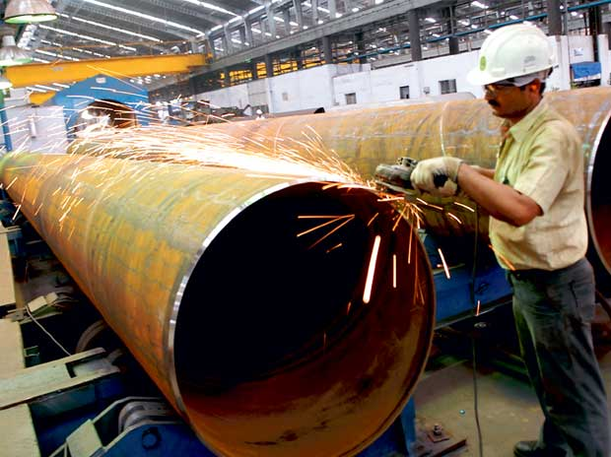

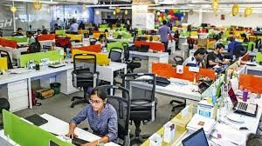
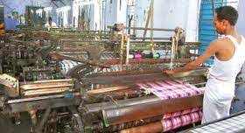
Industries/ Service sector/ professionals, we focus on
Textile
Diamond
Construction
Power sector
Manufacturing
Retail / FMCG
Hospitality (Hotels/ restaurants)
IT / ITES
Insurance
Transportation / logistics
Banking
Stock market
Medical
And many more…….
Coaching
Placement
Immigration
Co-Working
JOBS
FOR
JANTA
www.irojgar.com | irojgarmail@gmail.com | +91 77790 10101| +91 90816 28628

Slide 29

Our services for Job Seekers and Career Aspirants:
Coaching
Placement
Immigration
Co-Working
Registration and Placement of Job Seekers.
SMS Alerts for eligible job seeker
Career Guidance & Counseling.
Skill Development of job seeker in various aspects. (modular programs)
Training for Tribal Youth
To provide support & assistance service seeker from organized/ unorganized sector.
Special employment & self-employment guidance for differently-able persons.
Job Fair
Career Library
Preparation of interview
Preparation of CVs, resume
JOBS
FOR
JANTA
www.irojgar.com | irojgarmail@gmail.com | +91 77790 10101| +91 90816 28628

Slide 30

Our Commitment:
Coaching
Placement
Immigration
Co-Working
Interview Call for
Any Recruitment in just days. ….!!!!
15
JOBS
FOR
JANTA
www.irojgar.com | irojgarmail@gmail.com | +91 77790 10101| +91 90816 28628

Slide 31

Coaching
Placement
Immigration
Co-Working
JOBS
FOR
JANTA
www.irojgar.com | irojgarmail@gmail.com | +91 77790 10101| +91 90816 28628

Slide 32



Coaching
Placement
Immigration
Co-Working
iROJGAR
JOBS
FOR
JANTA
701/702, 7th floor, Joyos Hubtown, Adajan Bus Port, Surat-395009
Mobile No. : +91 77790 10101
WhatsApp No.: +91 90816 28628
Web : www.irojgar.com
Follow us:
www.irojgar.com | irojgarmail@gmail.com | +91 77790 10101| +91 90816 28628

Slide 33


Coaching
Placement
Immigration
Co-Working
JOBS
FOR
JANTA
www.irojgar.com | irojgarmail@gmail.com | +91 77790 10101| +91 90816 28628

Slide 34


Coaching
Placement
Immigration
Co-Working
JOBS
FOR
JANTA
Thank You
www.irojgar.com | irojgarmail@gmail.com | +91 77790 10101| +91 90816 28628

